Slide 1
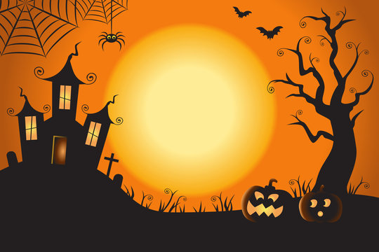
Monster Makey
Kevin Rubio
Jasmine Roach
Sam Downs

Slide 2


What is TAP?
TAP stands for the Technology Ambassador Program
TAP is a program that helps students develop skills in scholarship, leadership, service and creativity
The goal of this course is to increase an interest in ITEC concentrations
This program creates opportunities for students in introductory STEM courses and GGC outreach initiatives

Slide 3
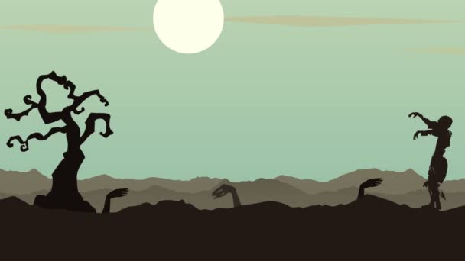
Goals of Monster Makey
Our goal is to introduce both tech and non tech students to learn about recording and editing sound files through a fun and interactive horror story Mad Lib activity. Recording hardware like mics, soundproof booths, and computers will be used to capture sound effects for provided stories for students to fill in. Editing software like Audacity or Garageband will be used to modify our audio, this will give them a chance to learn and get a deeper understanding of how sound waves and modifiers can do to a recording. Once complete, students will be walked through how to code their recordings into Makey Makey and allowed to integrate them into the stories. We wish to teach methods and applications students can use to record, edit, and export sound, as well as how to code that sound into programs like Scratch and Makey Makey.

Slide 4
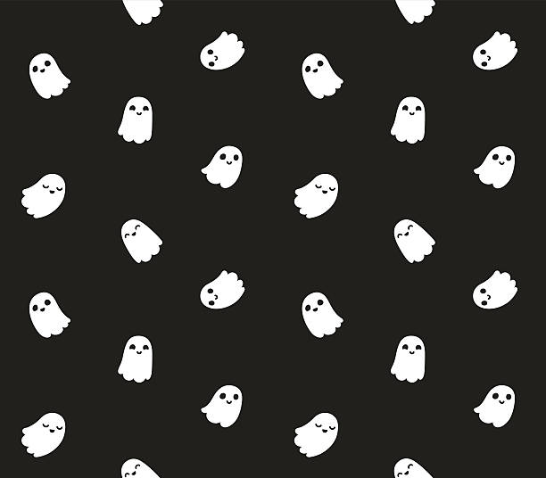
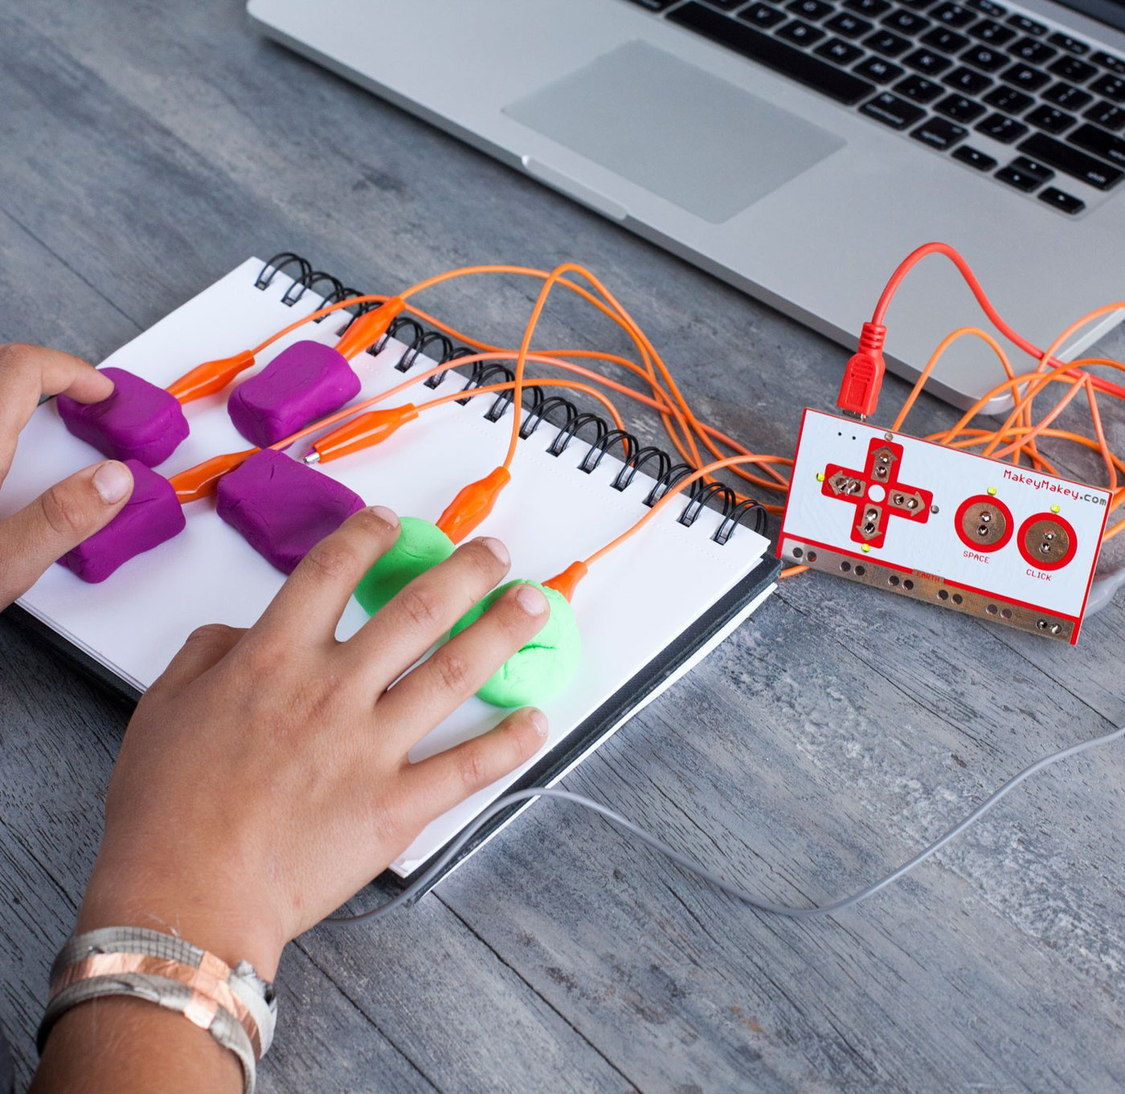
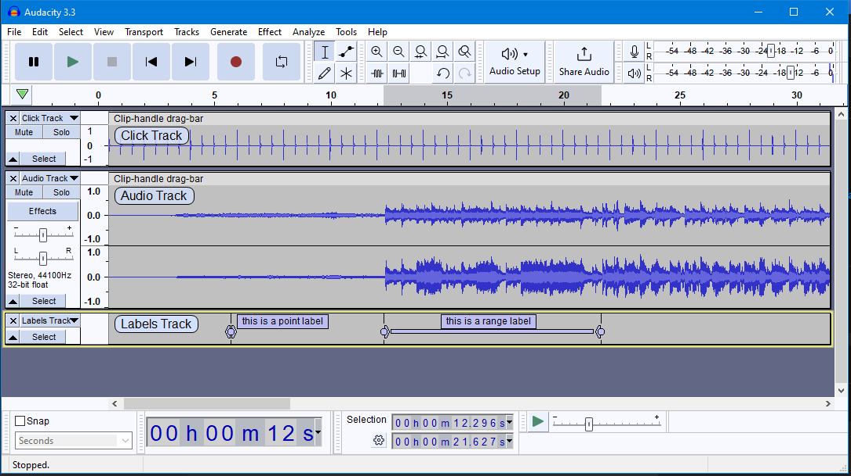
Project Description/Methods
To start, we will demonstrate how to use a Makey Makey,
with the use of a horror story. As the story is being told we
will include sounds, activated but the Makey Makeys to
create an immersive experience. We will then give a brief
explanation of how the audio clips we implemented were
recorded and edited by us.
The classroom activity will start with a demonstration of our
story and how Makey Makey can be used to insert sound clips.
We will then go over how we went about recording and
manipulating our audio and what applications we used to make
it happen. Then we will turn it over to the students, split into
groups, where they will have to edit pre-recorded sounds
and apply them to their given story from their own devices.

Slide 5
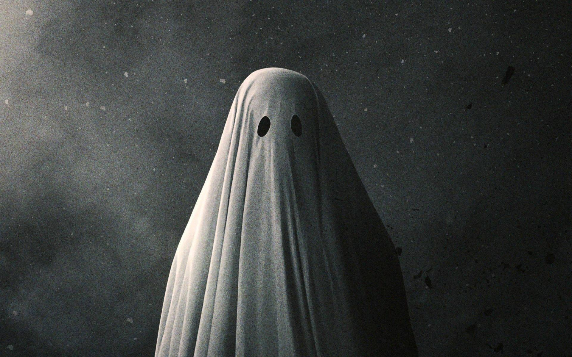
Story Time

Slide 6
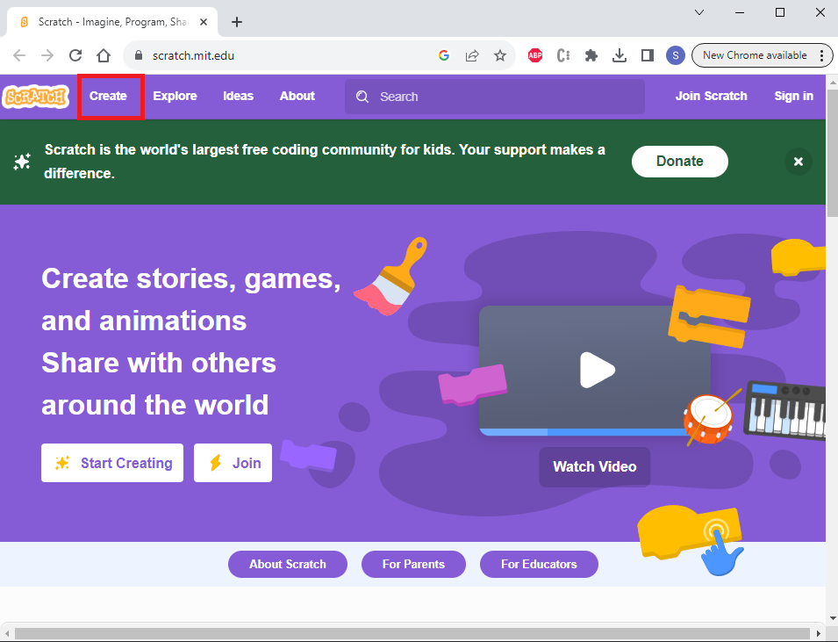
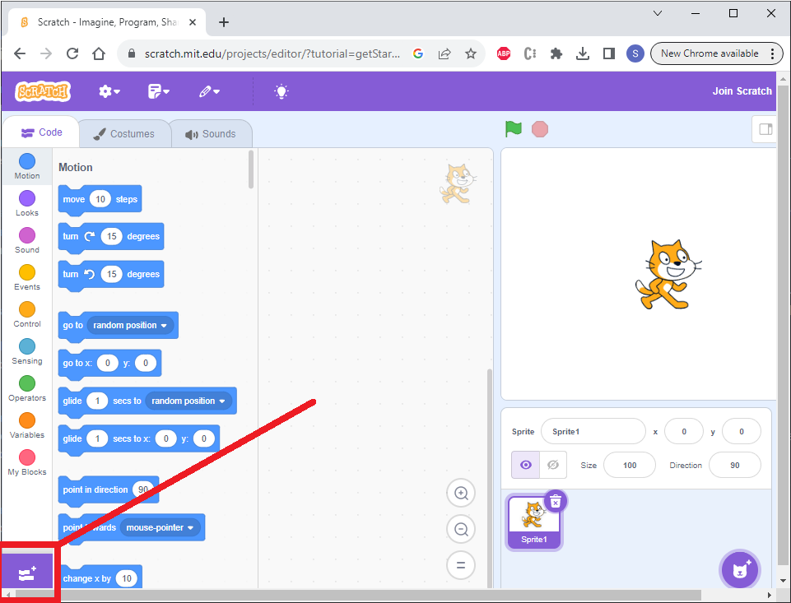
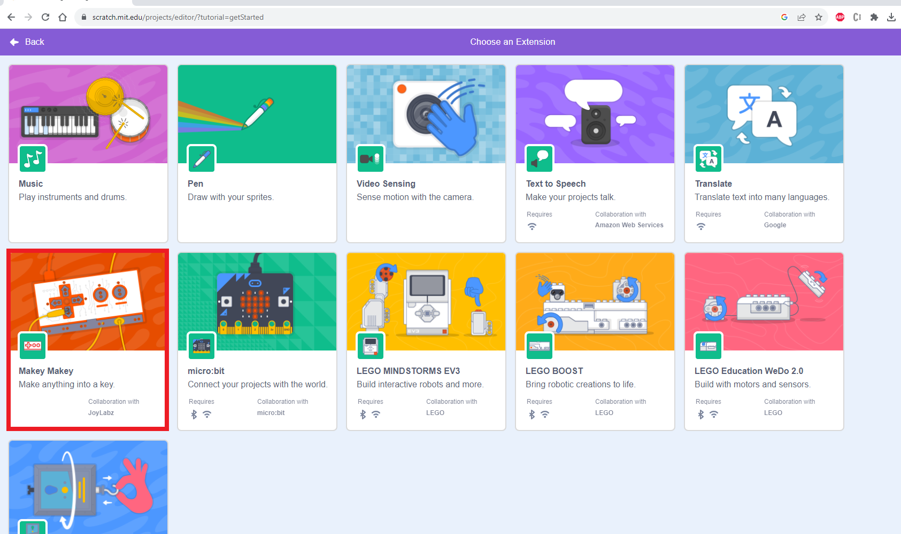
Setting Up the Makey Makey
Head to https://scratch.mit.edu/
Click on the “Create” button on the top left
Click the “Add extension” button on the bottom left

Slide 7
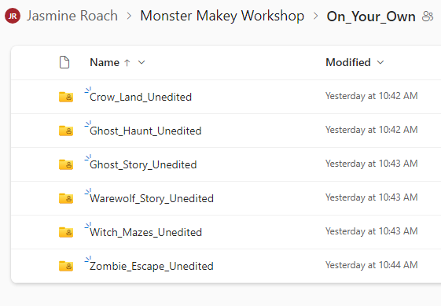
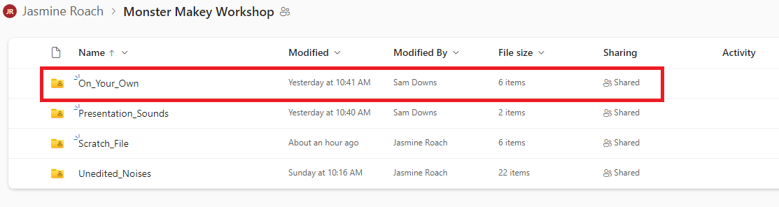
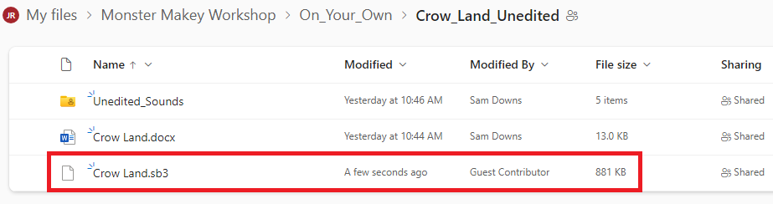
Downloading the Scratch File
In the onedrive, there is a folder named “On_Your_Own”, there are multiple folders that have a unique story

Slide 8
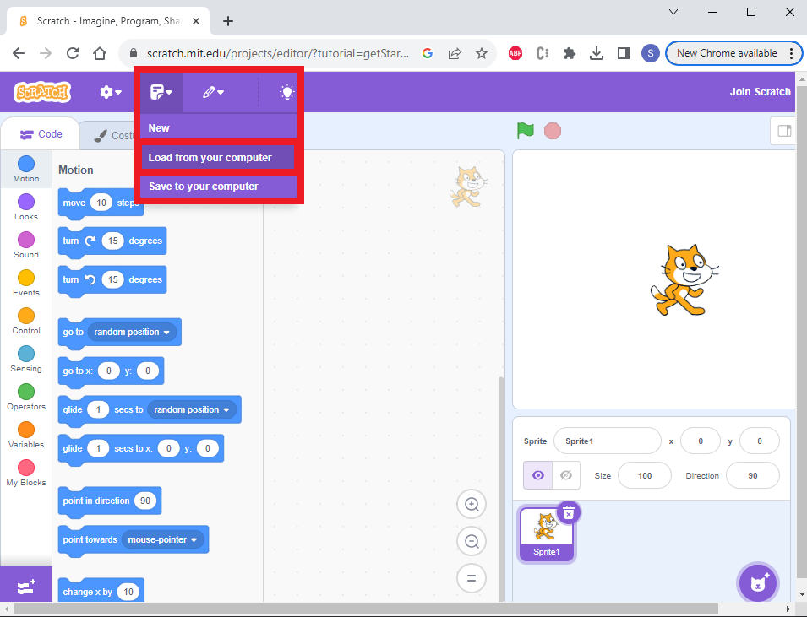
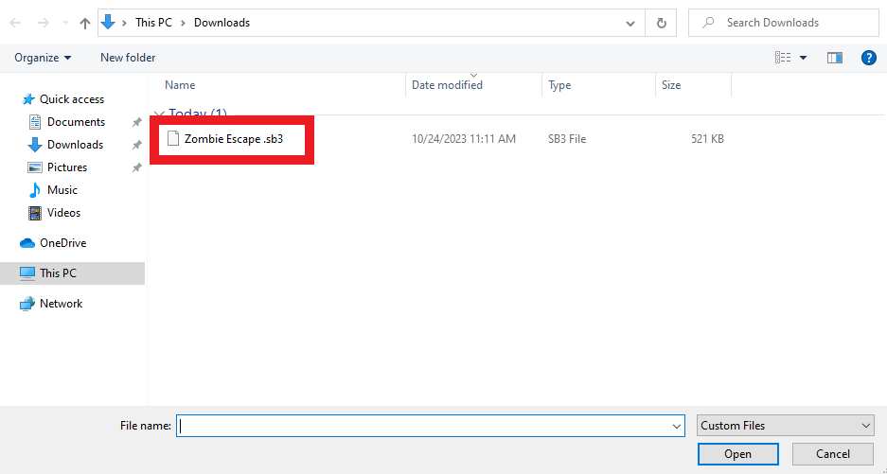
Setting Up the Scratch
Once you load the scratch file from your computer (choose the file ending with .sb3), you will be able to play sounds from the makey makeys
Now play around with makey makeys for a couple of minutes

Slide 9
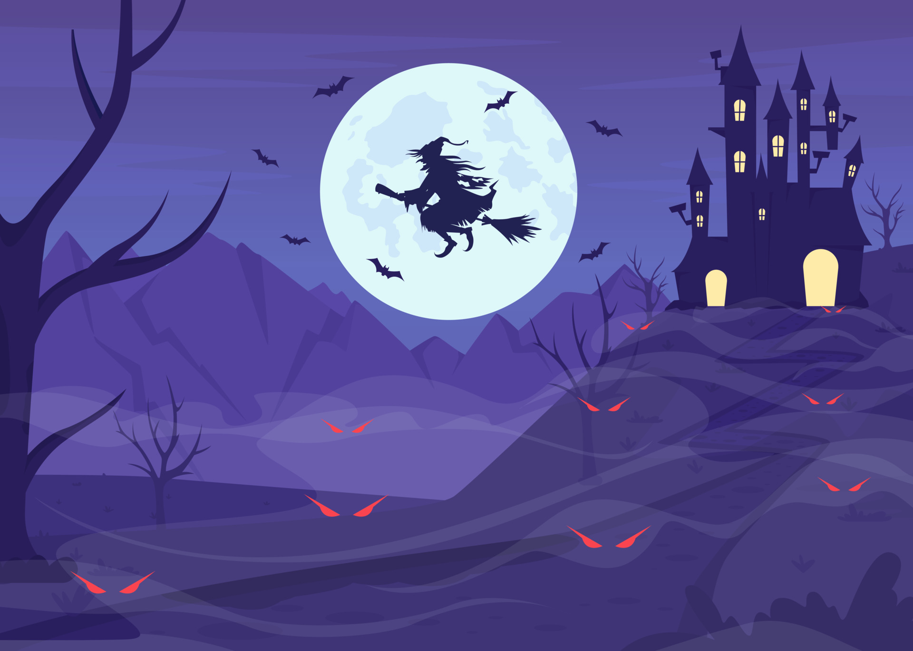
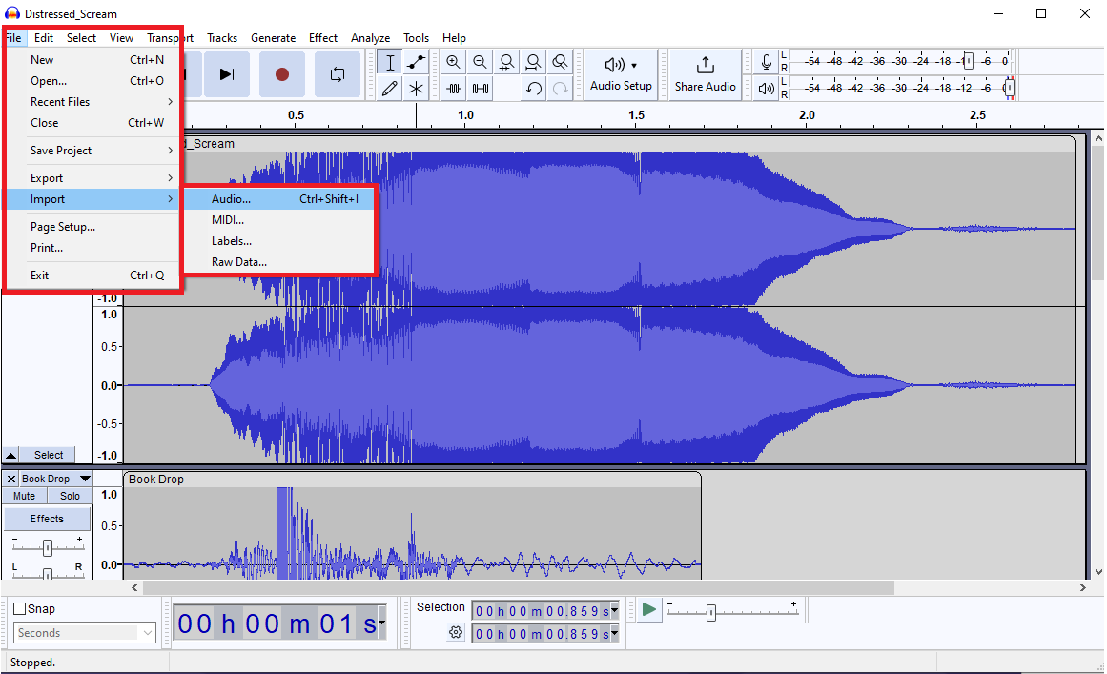

Workshop Description
Open up Audacity
In audacity head to “File”, “Import”, “Audio”, and select all the .mp3 files in the “Presentation_Sounds” folder
Finally you should be able to see multiple tracks with seperate “soundwaves” on your screen.

Slide 10
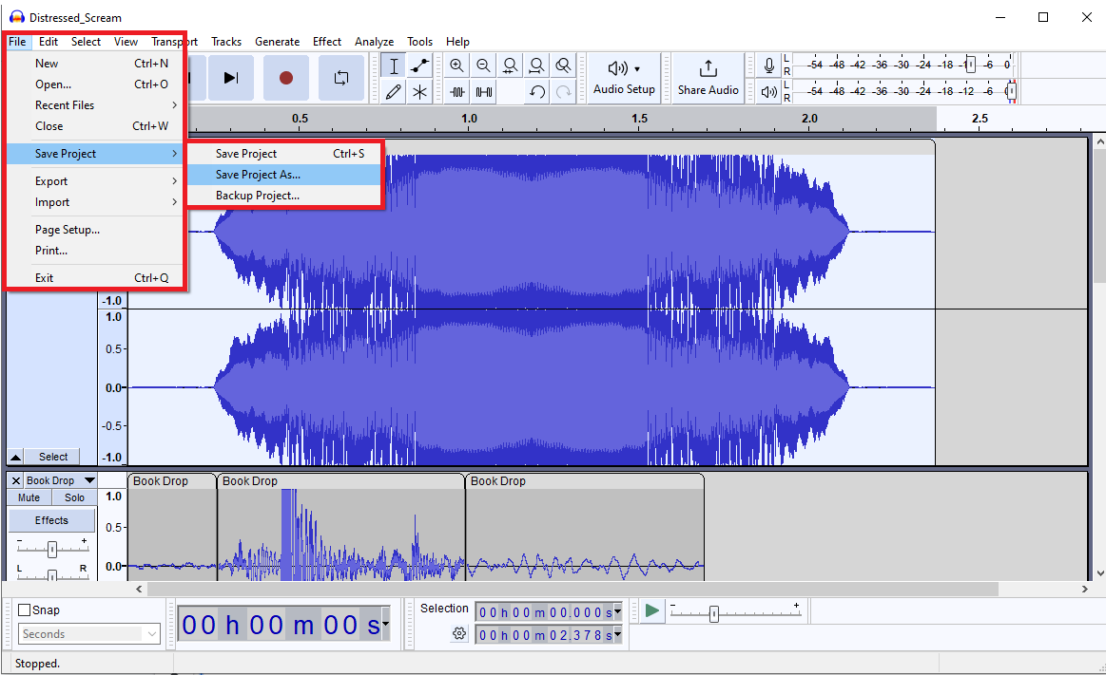
Saving the project
Note that saving the project is not the same as saving the audio files
To save the project, go to file, save project, save project as…

Slide 11
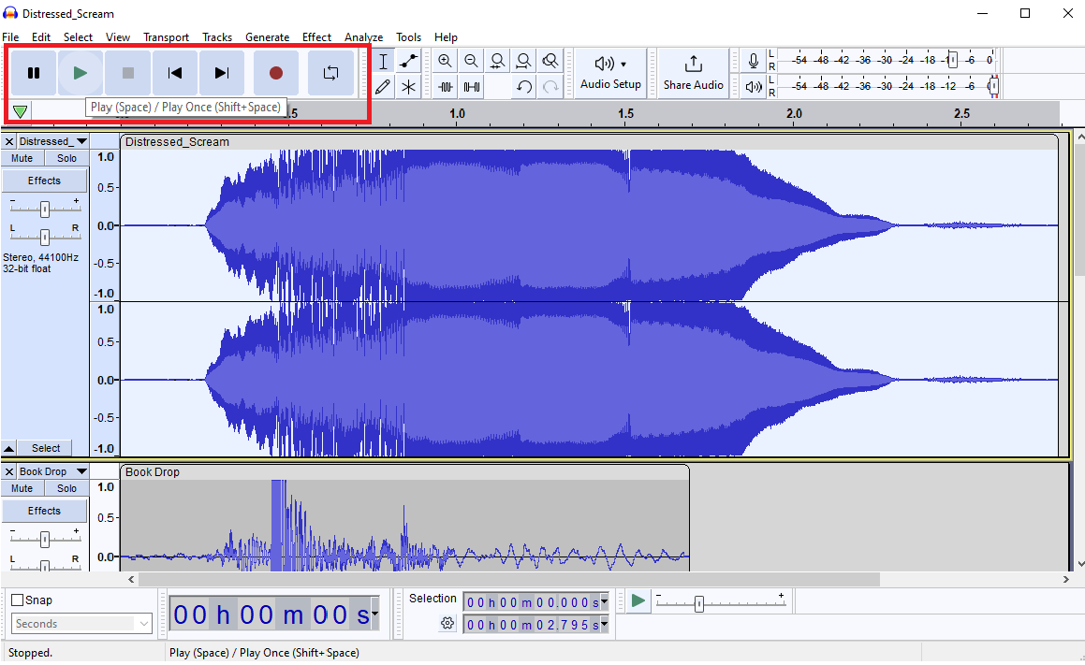
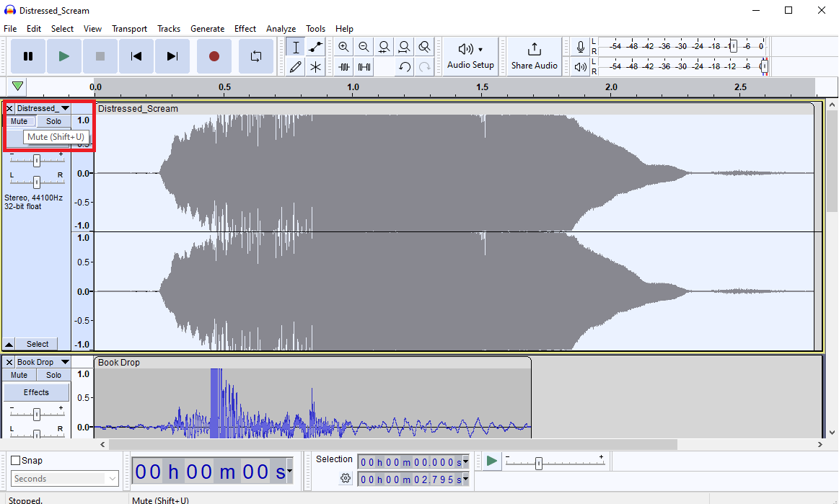
Play/Mute/Solo
At the top left of the screen, you can play/pause the sound(s)
To select certain tracks to not play, you can mute the track (press the mute button under the name of the track)
To only play a certain track, you can solo the track (press the solo button next to the mute button); this mutes every other track
Play/Pause
Mute/Solo

Slide 12
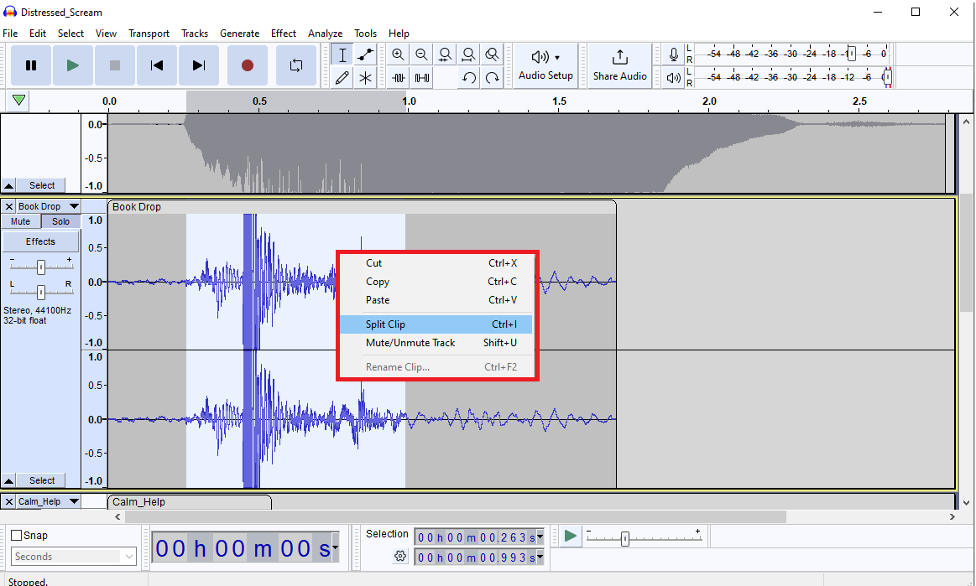
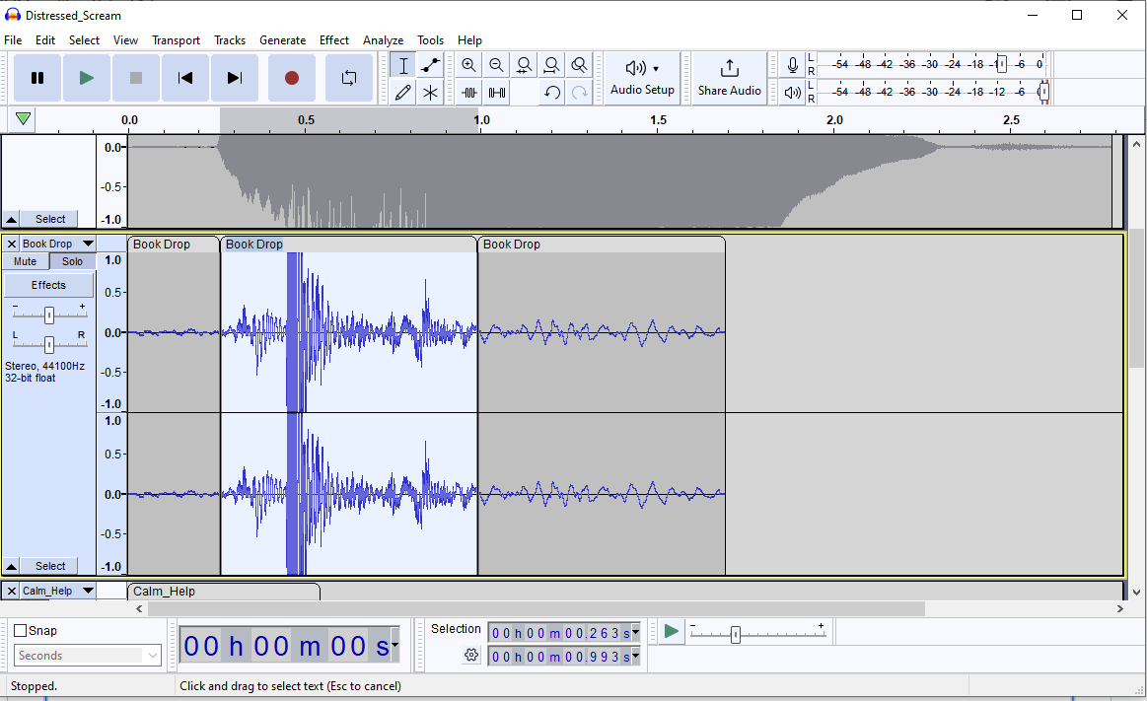
Selecting/Cutting Parts of the Audio
By left clicking and holding then releasing to either the left or the right, we can select a part of the audio (to select the whole track, click the blank part of the blueish gray box)
When selected, you can play the audio and split the audio (you can also cut/copy/paste or delete the audio (remember that you can ctrl+z to undo!))

Slide 13
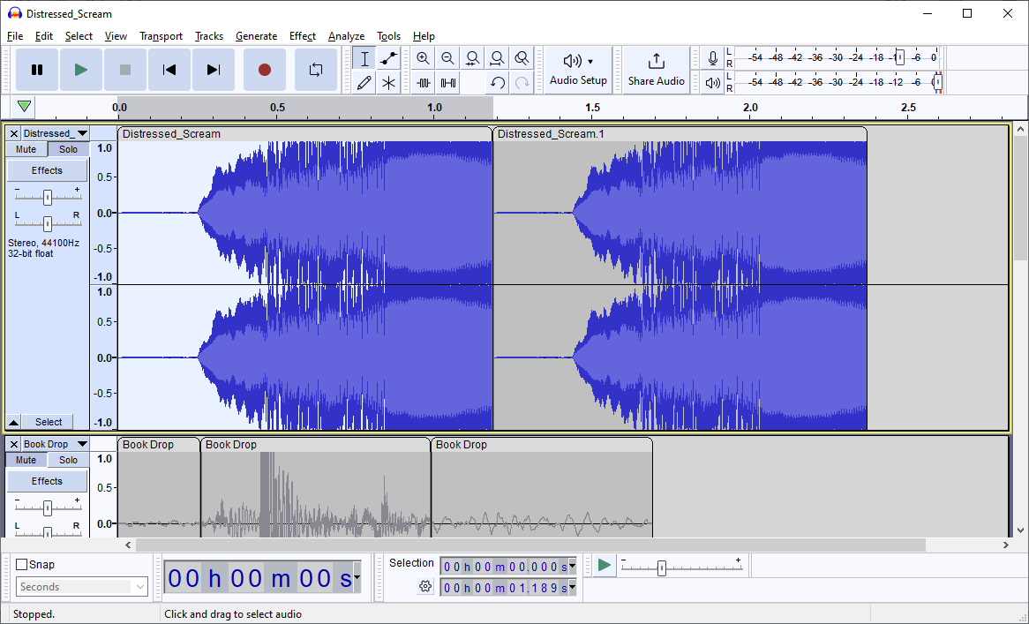

Special Effects: Reversing Sound
Solo the Distressed_Scream
Select the first half of the scream (bonus: try to get the selection to end right before the voice crack)
Split the section, then delete the second half
Then copy and paste the selection
Un-reversed
Reversed

Slide 14
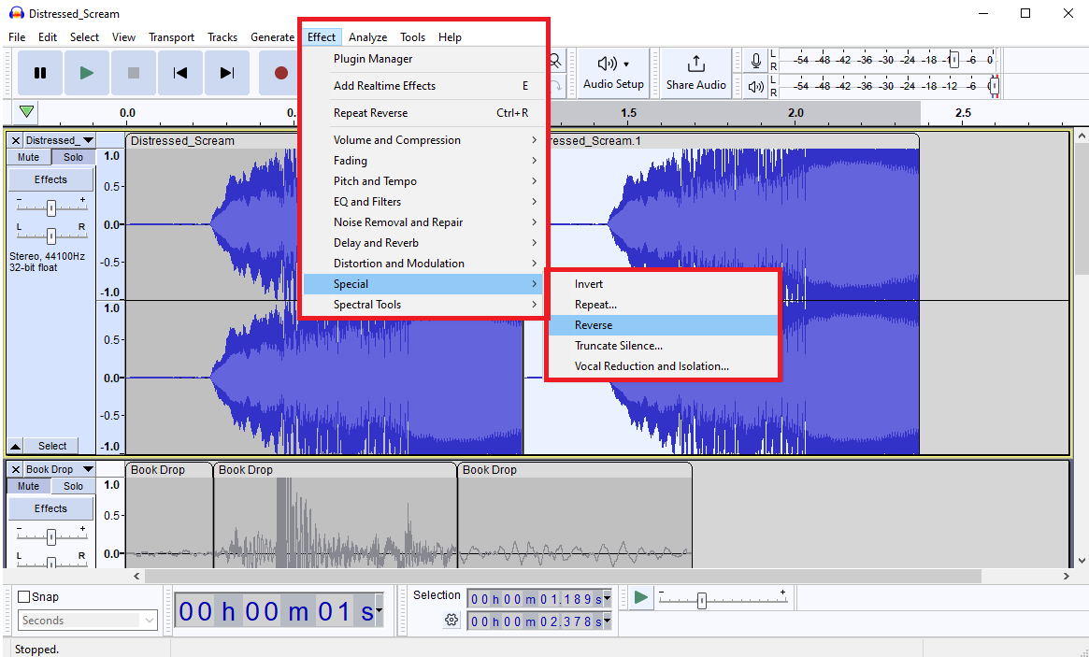
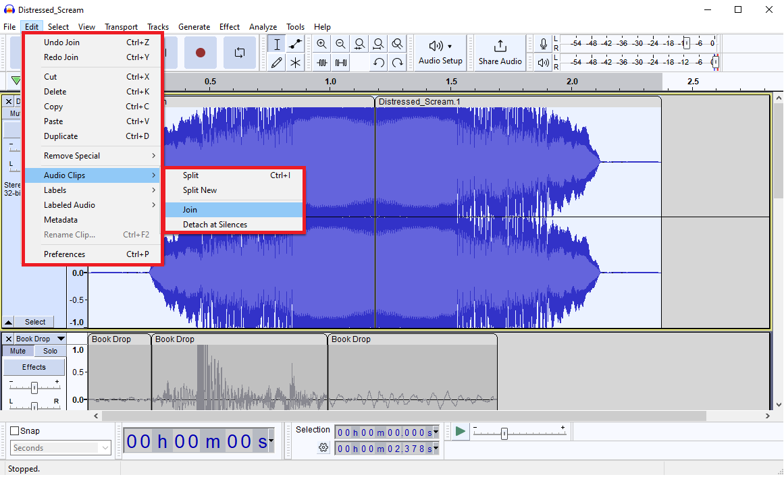
Special Effects: Reversing Sound 2
Now click on the second section of the track and go to effect, special, and select reverse
Then to join the two clips, select the whole track, then go to the edit tab, audio clips, join

Slide 15
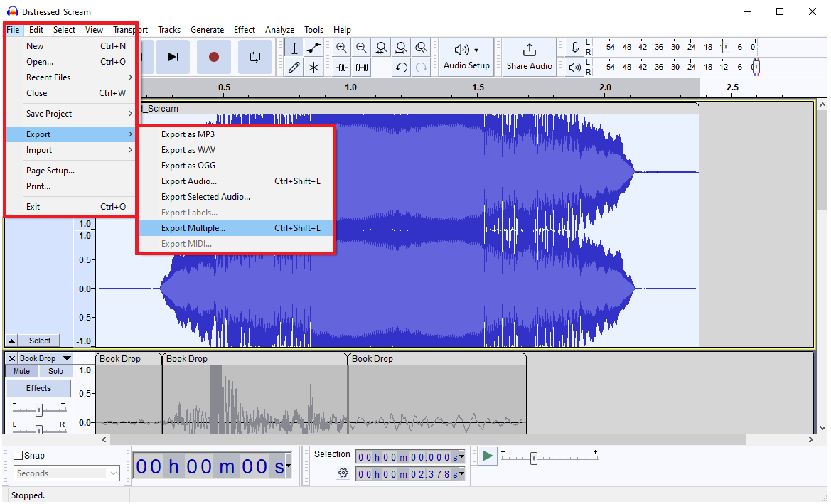
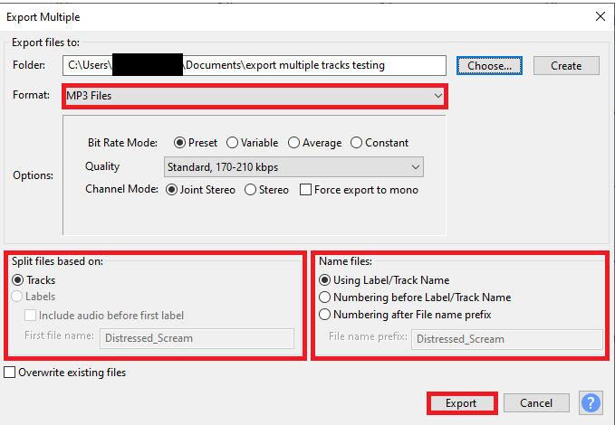
Exporting Each Track Separately
To export each track separately, make sure that all the tracks you want to export are unmuted (you can unmute all the files by soloing a track then pressing solo for that track again); then go to file, export, export multiple (note that if you export the project as .mp3, all the tracks will combine into one audio file)
Make sure to choose .mp3 as the format, tracks as the “split files on” and name files using track names

Slide 16
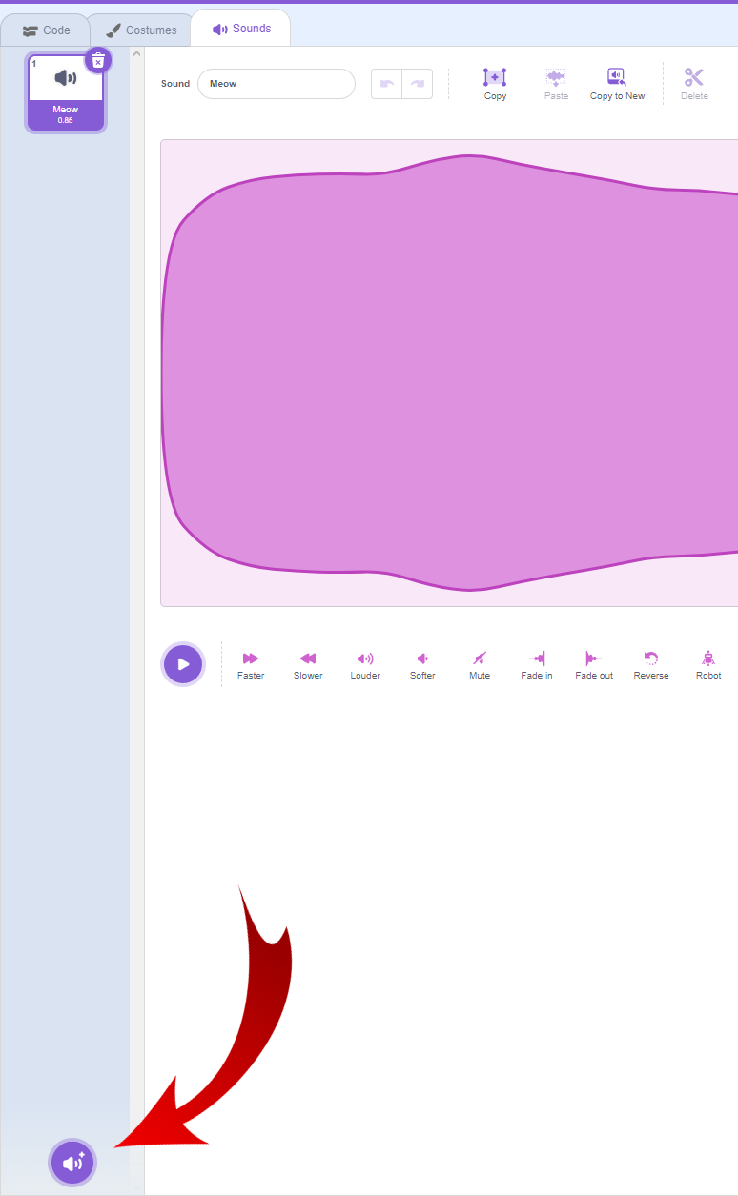
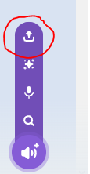
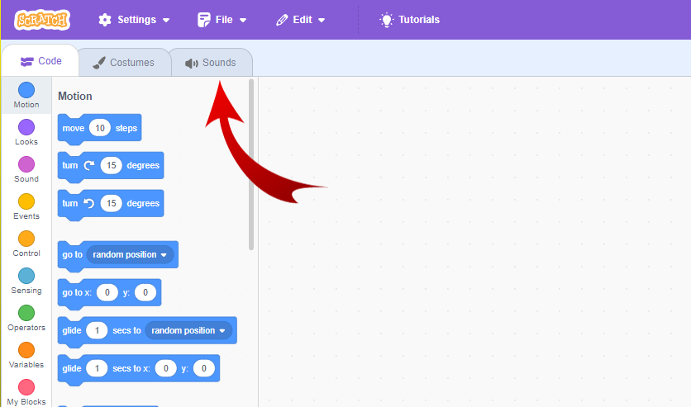
Uploading Your Sound Effect
In scratch head to sound, then at the bottom
left corner click the sound icon.
From there click the upload button (the one circled
in red) and upload your sound effect.

Slide 17
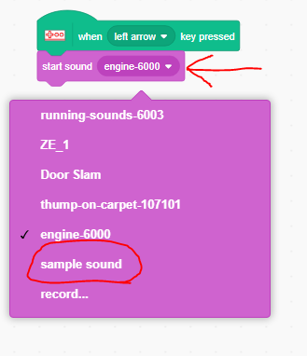
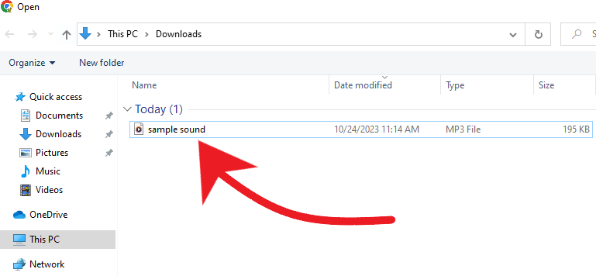
Uploading Your Sound Effect (Cont.)
Click on the sound effect file you created
You will see your sound in scratch
Go back to the code screen, and change the
Sound to your newly uploaded sound

Slide 18
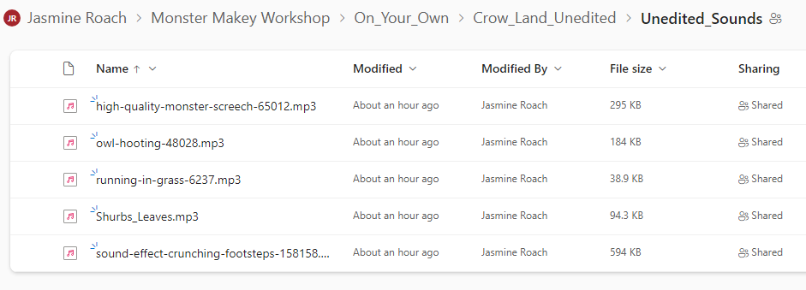
On your own
In the onedrive, there is a folder named “On_Your_Own”, there are multiple folders that have a unique story

Slide 19
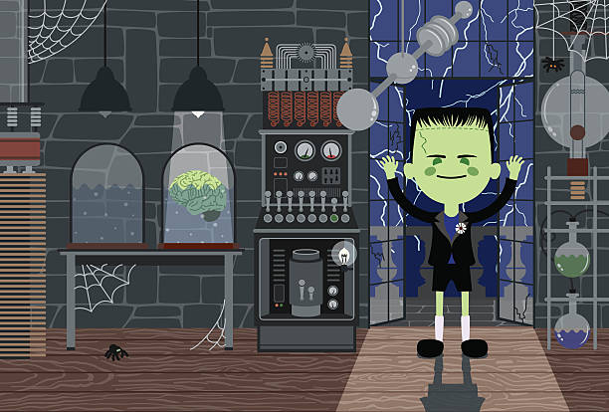
Results of Monster Makey
What did you think of our Project?
What was your favorite part of Monster Makey?
What could be done to improve the project?
Would you recommend this to other classes?

Slide 20
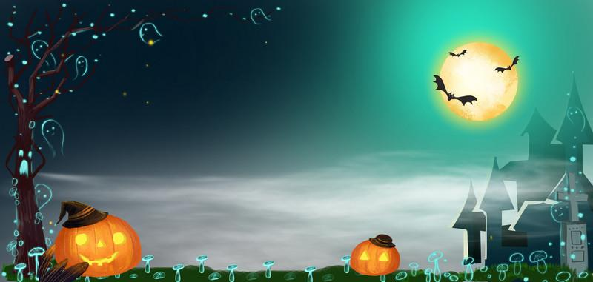
Questions

